Slide 1
[Title of Investigation]
For Internal Use Only
RCCA Analysis
Author :
Date :
Notes:
This 8D Template shall be used for both Automotive products and Consumer products. The slide titles of this template indicate which step of the 8D analysis should be documented. Before proceeding with the 8D analysis using this template the user should review the 8D Training video to clarify the scope and steps to follow in performing an 8D analysis. See details in last item in the notes on this page.
Enter the following in the slide:
Title of the investigation
Possible Status Settings:
Draft
Under Review
Reviewed
Approved
Obsolete
The 8D template is a document that must be completed as the investigation advances, when all information is available and actions can be noted and tracked.
Do not wait until the effort is completed to try to complete the 8D form.
When populating the 8D, it is necessary to include customer names and IPs affected, to have an effective 8D. This will be for internal use only.
If there is a need to share the 8D with a customer, please refer to the notes in Section D8 on how to prepare the customer version of this document.
When starting a new problem investigation, be sure to pull the latest 8D template from: https://sp-sg/sites/sgqms/QMSTools/8D%20Information/Home.aspx
Please note that 8D Audio/Visual training can be found in the online SuccessFactors learning module under Synopsys Employee Central.

Slide 2
CONFIDENTIAL INFORMATION
The information contained in this presentation is the confidential and proprietary information of Synopsys. You are not permitted to disseminate or use any of the information provided to you in this presentation outside of Synopsys without prior written authorization.
IMPORTANT NOTICE
In the event information in this presentation reflects Synopsys’ future plans, such plans are as of the date of this presentation and are subject to change. Synopsys is not obligated to update this presentation or develop the products with the features and functionality discussed in this presentation. Additionally, Synopsys’ services and products may only be offered and purchased pursuant to an authorized quote and purchase order or a mutually agreed upon written contract with Synopsys. This document shall not be considered a standard deliverable of Synopsys and shall not set any precedent for the creation or sharing of such documents in the future.

Slide 3
The Team
Name | Title | Role in this 8D
 | RCCA Lead | Accountable for … setting the pace organizing & moderating meetings facilitating critical analysis deciding slide content & quality
 | Project Engineering Manager (PEM) | PEM that managed the project and is responsible for interface between technical teams and the customers
 | Engineer | performed the original tasks & work
 | Engineer | performs the technical debug & correction actions
 | Process Lead/owner | Expert on the process used during project execution. Aid RC discussion and help decide how to enhance process (i.e. Preventive Actions)
Notes: Roles are placed as guidance (not requirement). More than one person can play multiple roles.
Notes:
Establish a team of people (3-6) with first-hand knowledge of the issue and relevant processes.
Typically include R&D managers/senior engineers responsible for the development of the affected product, and PEM who would be knowledgeable of the IP releases and customers.
List the leader/author of this 8D Investigation first.
List only Synopsys employees.
For Automotive products, include the Safety Manager and any other members of the Functional Safety team involved.
Determine the frequency of the meetings to be held.

Slide 4
RCCA - Process
 | General Description | Additional Synopsys-Specific Advice
Problem Statement | Investigation of the problem, up to causal factor. This is all part of understanding and describing the problem. | Summarize the problem and share relevant details to align everyone involved, including customer.
Root Cause Analysis | Analysis of the process and how it failed. | Conduct 5 Why Analysis to answer what is missing or flawed in the process. How did this issue escape detection?
Preventive Actions | Create action plan – who does what, and by when? Note that several steps may need to be carried out in order to successfully implement 1 preventive action into the process. Execute the action plan. | How to improve process and avoid re-occurrence in the future. What scripts, tools, flows, checklists, or documents need to be created or improved? Follow up on all actions until completed, and record completion dates. Assign clear owners.

Slide 5
Overview
Product Affected | dwc_*
Technology | (e.g.tsmc12ffc)
Product Release Version
R&D Project Name
Customer reported or internally discovered? And at what step?
Date Synopsys first learned of issue | <Month DD, YYYY>
Customer CASE Number (If Applicable)
STAR Number (if Applicable) | P80001562-####
Is this an automotive product?
If so what is the name of the safety manager?
What is the date the safety manager learned of this problem? | <Month DD, YYYY>
contact PEM for info
Notes:
If this is an automotive product, and a safety related issue, then the safety manager needs to contribute and/or provide oversight to all sections of the analysis.

Slide 6
Describe the Problem - Body
Describe problem to align everyone
use black text & indent answers
Where was it discovered (e.g. simulation, silicon, proto evaluation, ATE dev, production, field)?
use black text & indent answers
What should have been the correct functionality/spec?

Slide 7
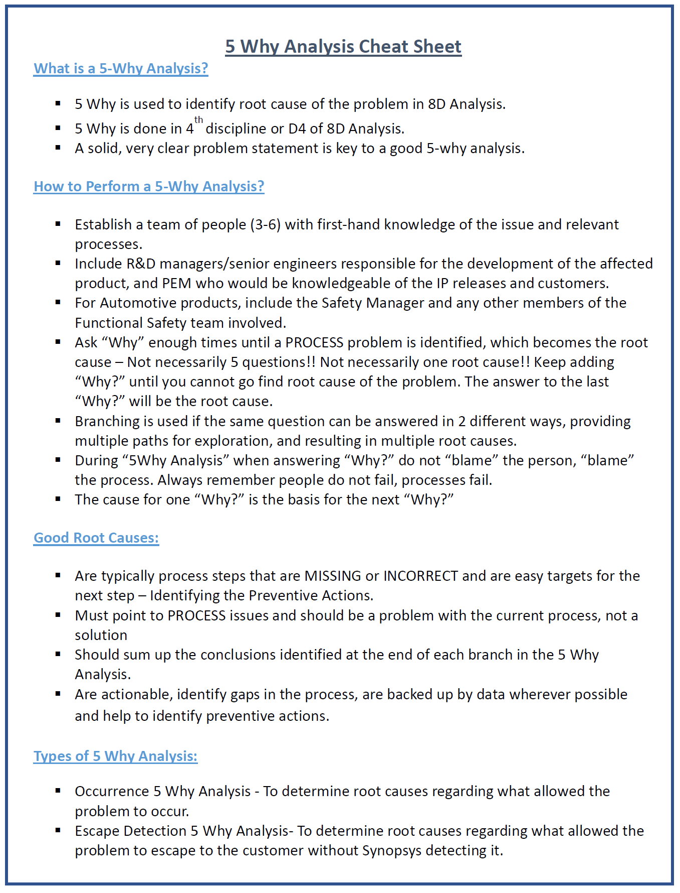

Slide 8
Root Cause Analysis - Why did the Problem Occur?
Questions | Answer
Why 1…? | Blah blah blah
Why 2…? | Blah blah blah
Why 3…? | Blah blah blah
Why 4…? | Blah blah blah
Why 5…? | Final STATEMENT here = RC
RC1-
Questions | Answer
 | Blah blah blah
 | Blah blah blah
Why 3…? | Blah blah blah
Why 4…? | Blah blah blah
Why 5…? | Final STATEMENT here = RC
RC2-
branch
if needed
Root Cause (Occurrence):
RC1 -
RC2 -

Slide 9
Root Cause Analysis - Why did Problem Escape Detection?
Questions | Answer
Why 1…? | Blah blah blah
Why 2…? | Blah blah blah
Why 3…? | Blah blah blah
Why 4…? | Blah blah blah
Why 5…? | Final STATEMENT here = RC
RC3-
Questions | Answer
 | Blah blah blah
 | Blah blah blah
Why 3…? | Blah blah blah
Why 4…? | Blah blah blah
Why 5…? | Final STATEMENT here = RC
RC4-
branch
if needed
Root Cause (Escape Detection):
RC3 -
RC4 -

Slide 10
Preventive Actions
Action Identifier | Action Description | Name | Status | Estimated Completion Date <Month DD, YYYY> | Actual Completion Date <Month DD, YYYY> | Addresses Which RC? | Comments
PA1 |  |  |  |  |  | RC1
PA2 |  |  |  |  |  | RC2
Root Causes Summarized Again for Reference:
RC 1 -
RC 2 -
RC 3 -

